Slide 1
Advice on how best to utilise aspects of Office 365 in a school environment
Overview of email encryption, Teams management and Sharepoint administration in Office 365.
Alex Forrest

Slide 2
Email Encryption in O365
The Old Style and The New Way

Slide 3
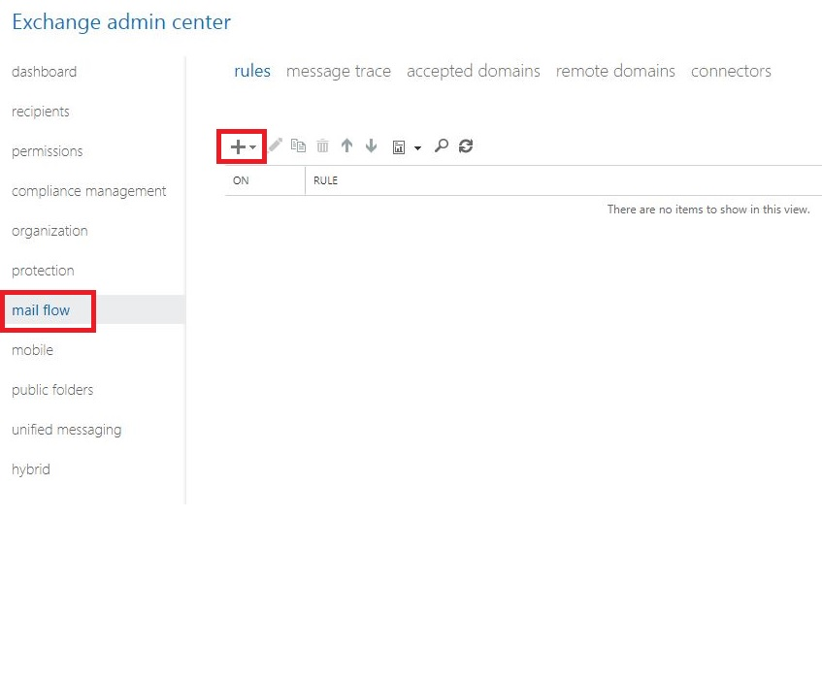
Create a transport rule

Slide 4
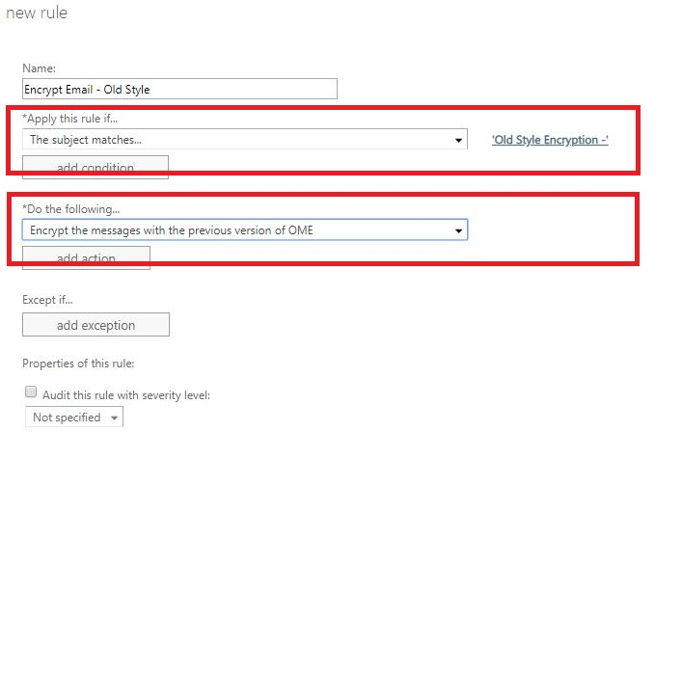
Rule to be applied based on subject

Slide 5
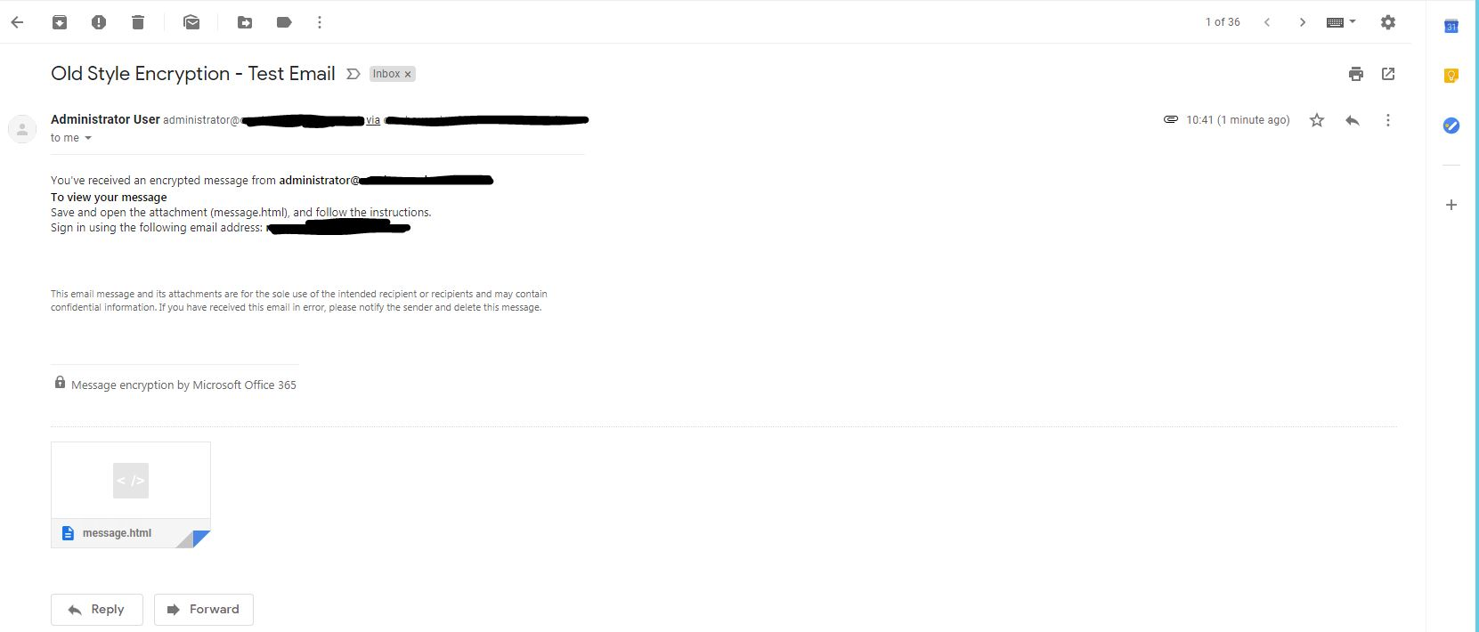
Message Received by Recipient

Slide 6
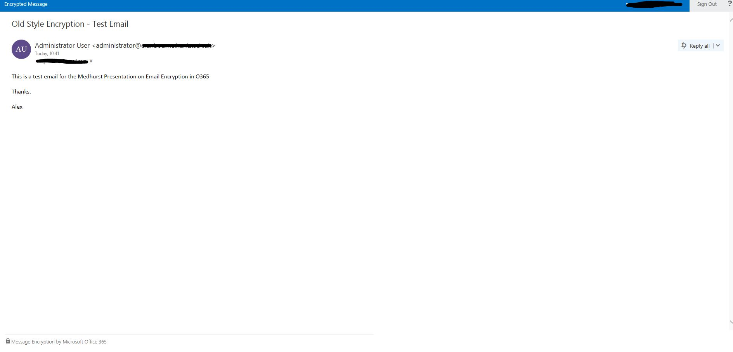
Email in O365

Slide 7
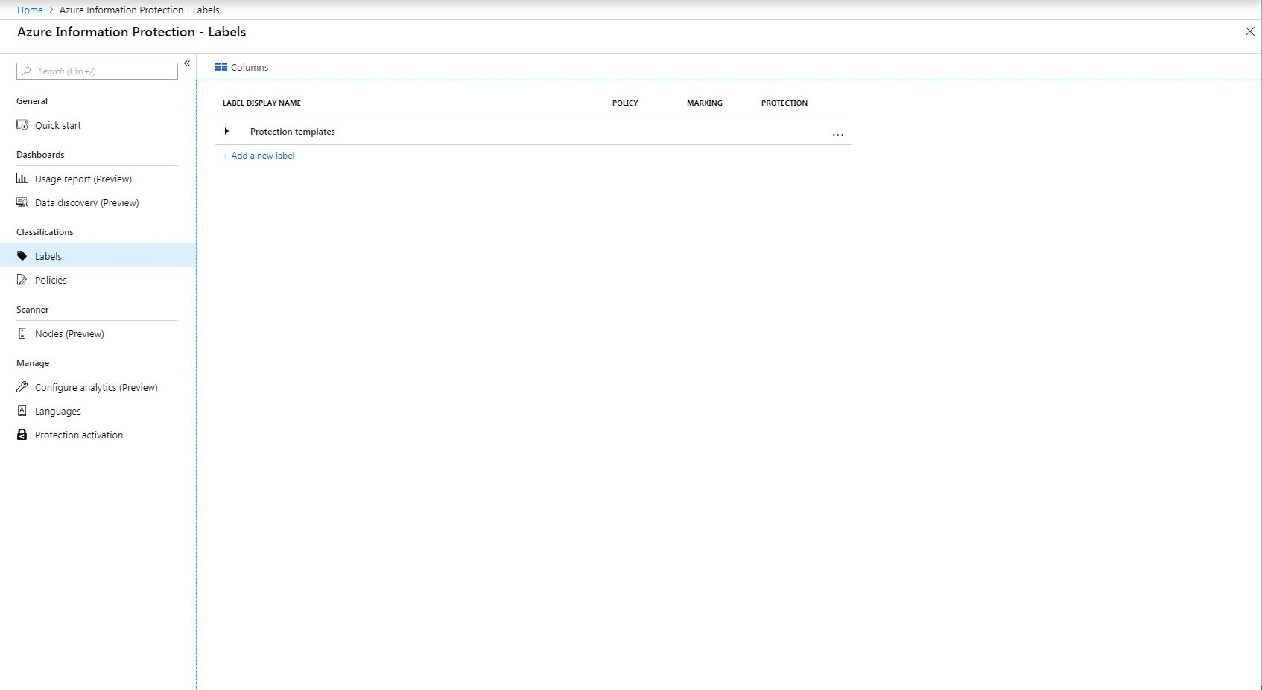
Azure Information Protection

Slide 8
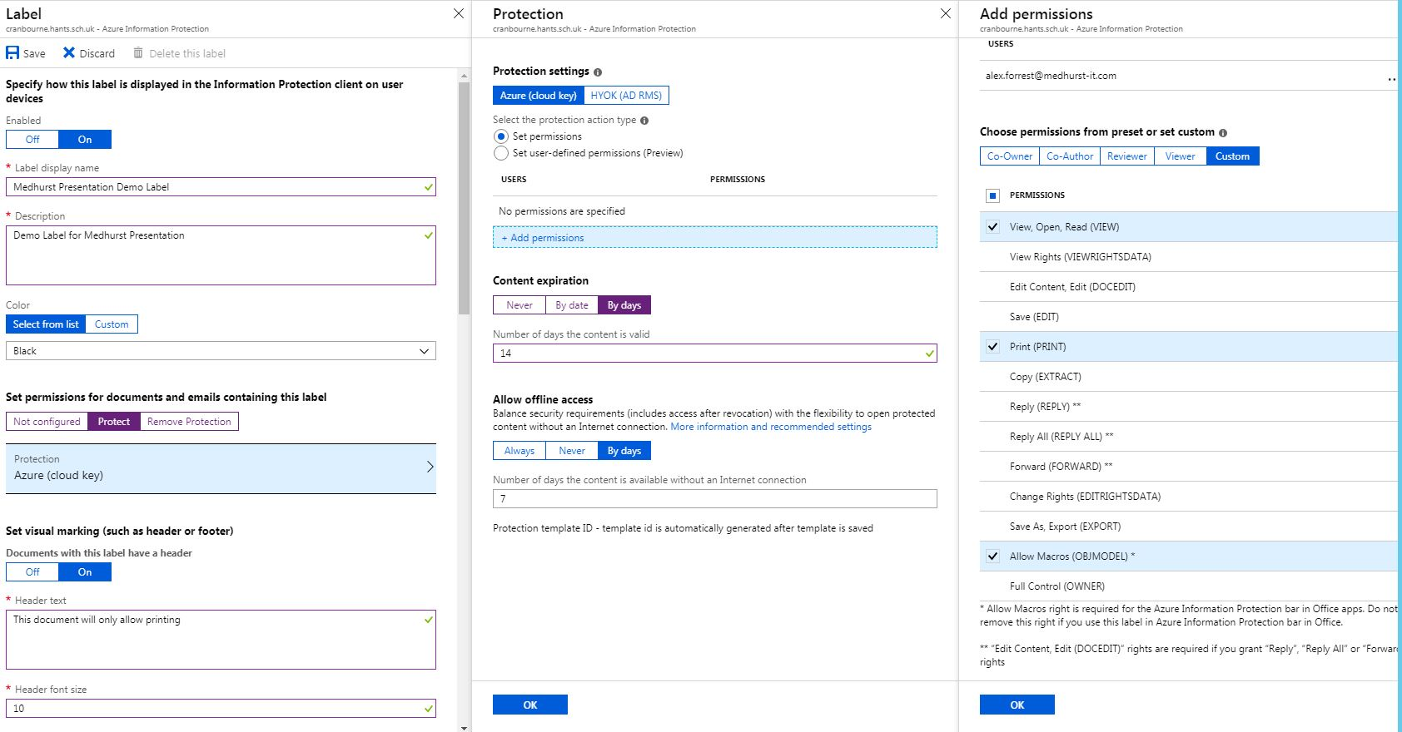
Label that defines our restrictions

Slide 9
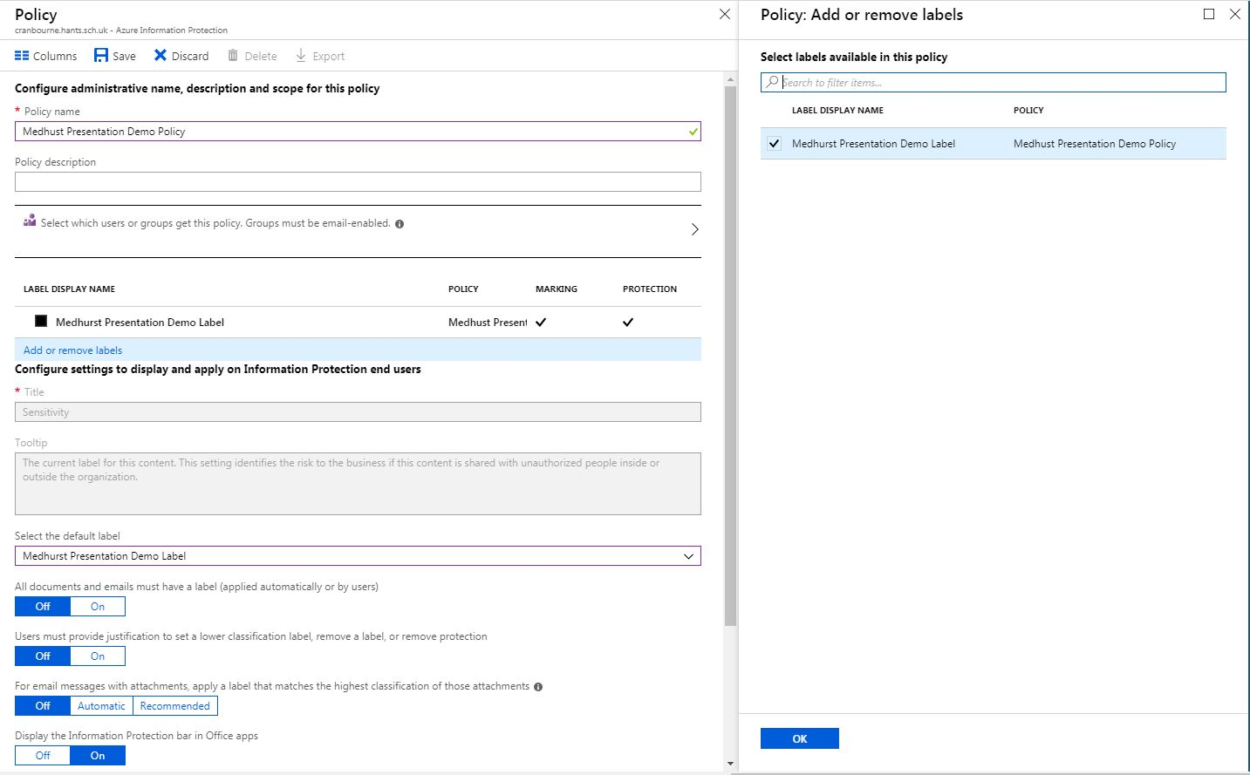
Policy that deploys our label to users

Slide 10
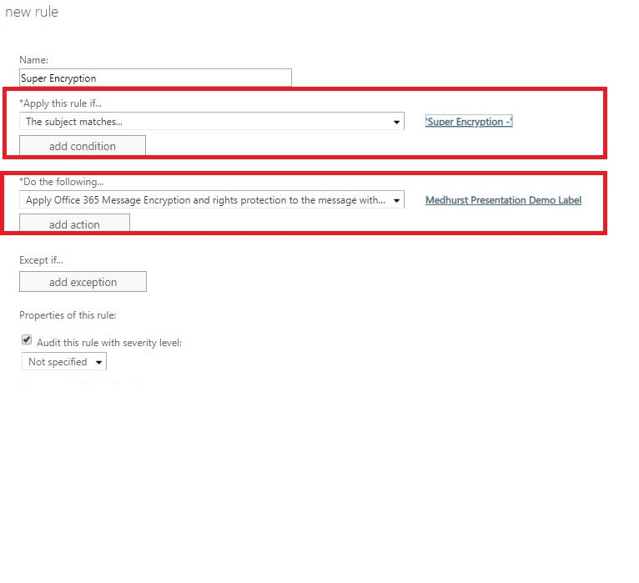
Transport rule that applies our label

Slide 11
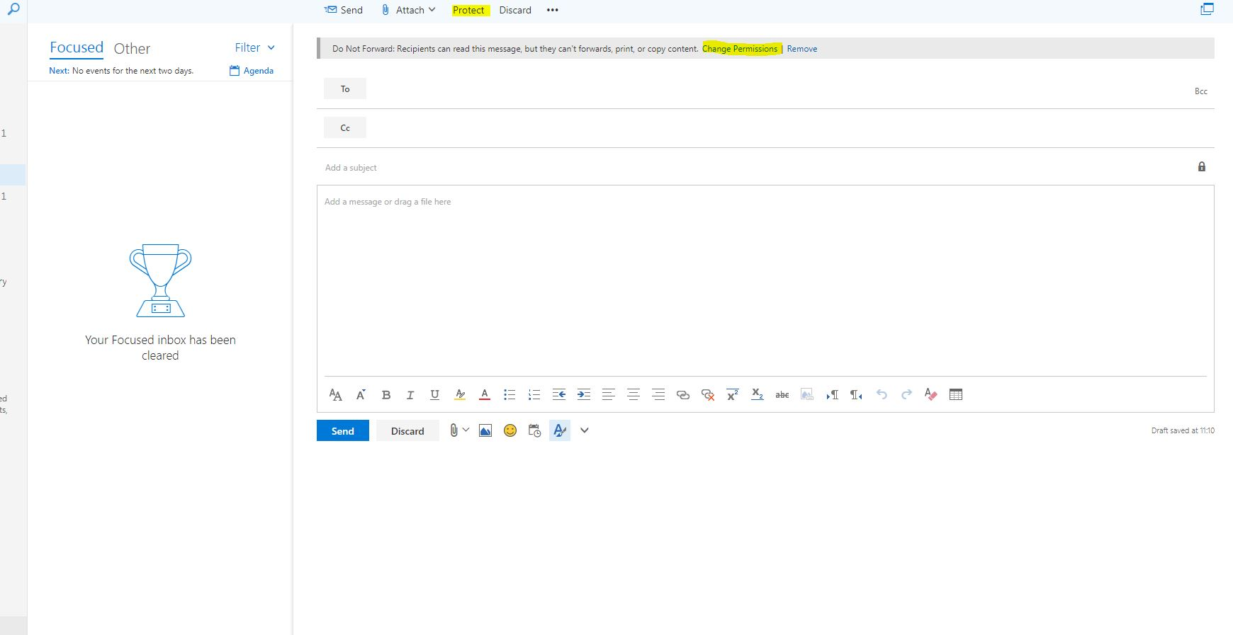
Users can apply labels themselves

Slide 12
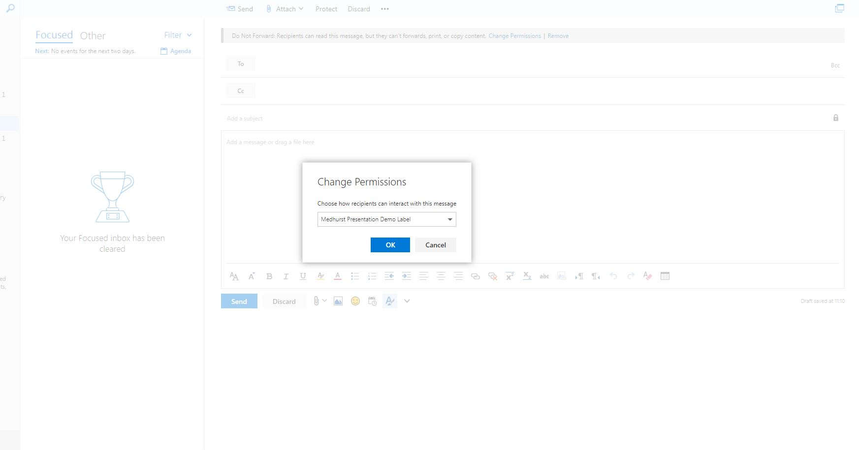
Label is available in OWA and Outlook

Slide 13
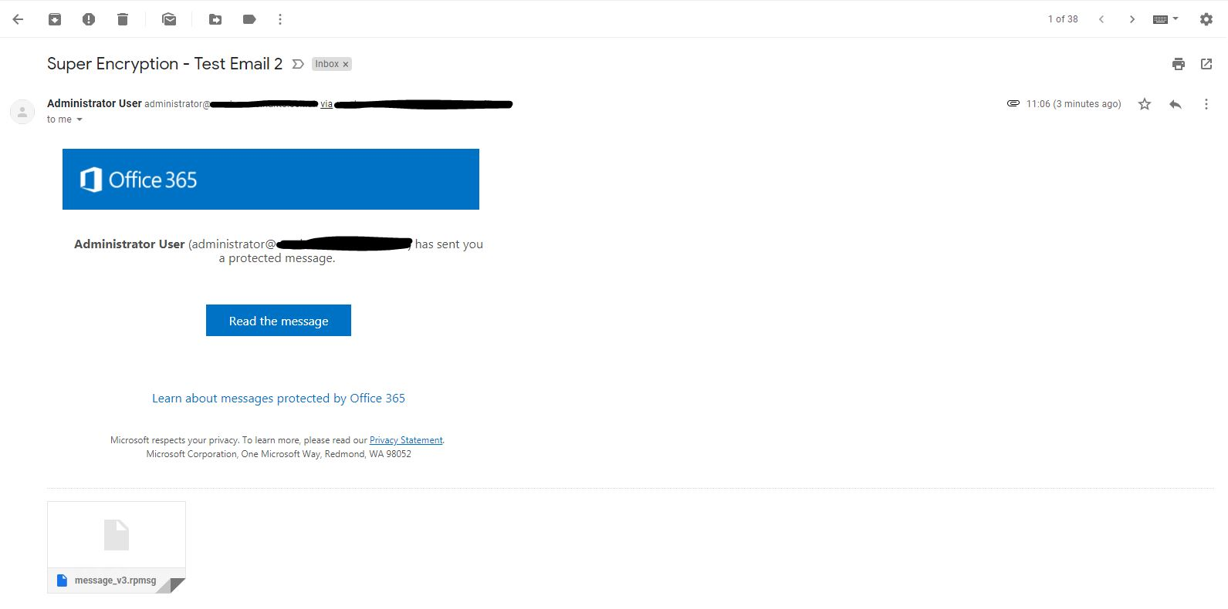
Message received by recipient

Slide 14
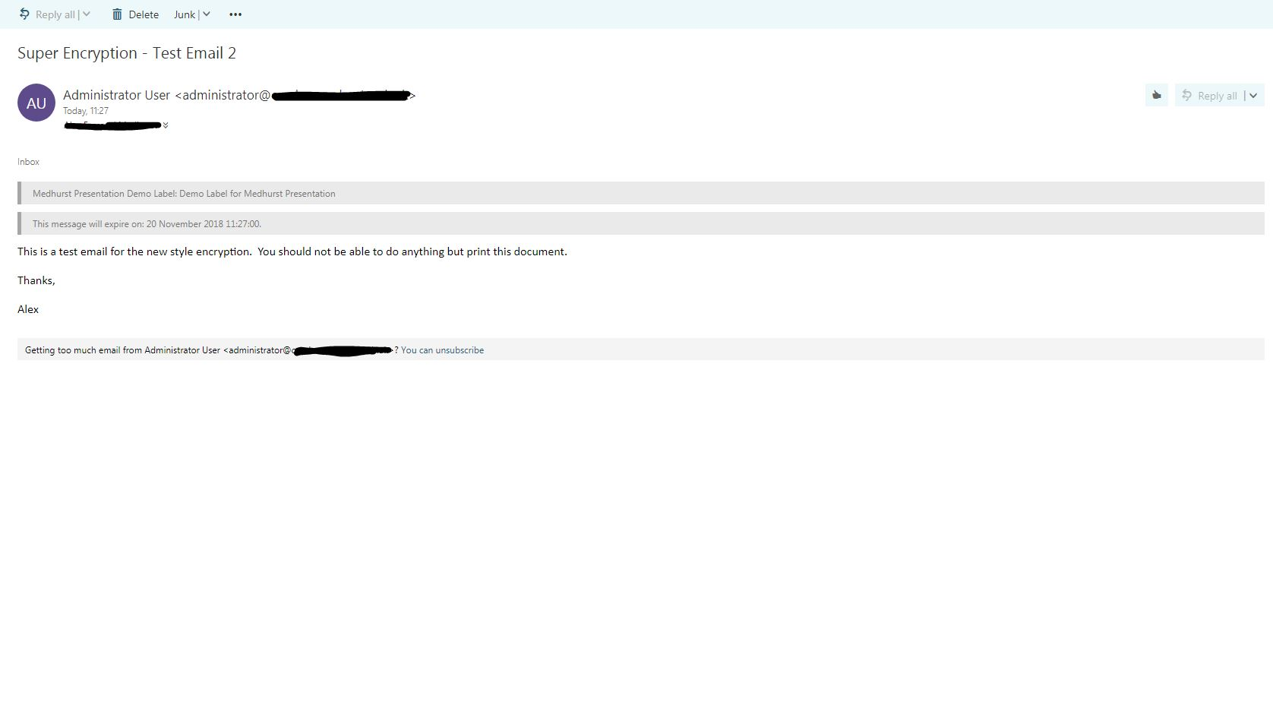
Message in O365

Slide 15
Microsoft Teams
Classes, Permissions and the future

Slide 16
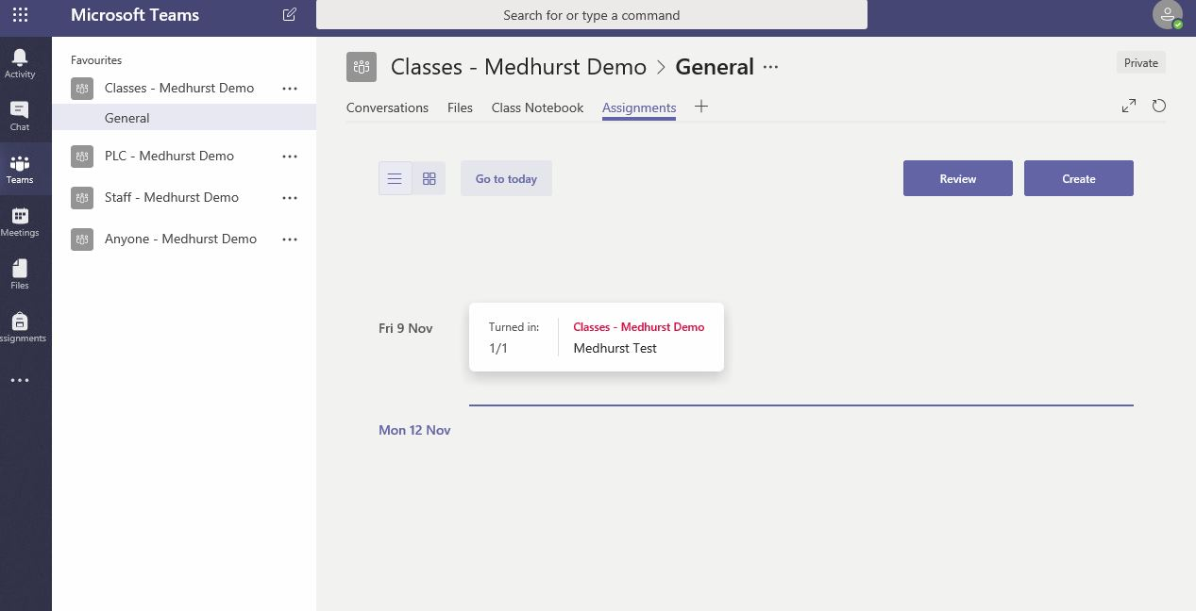
Assignment Calendar

Slide 17
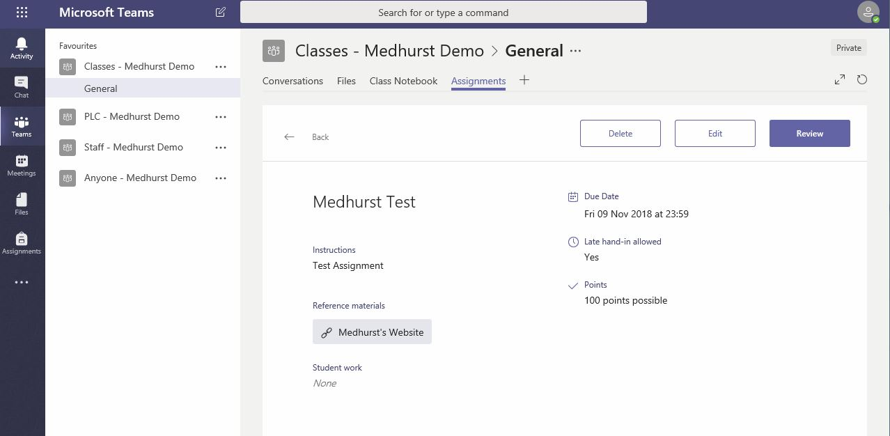
Assignment Details

Slide 18
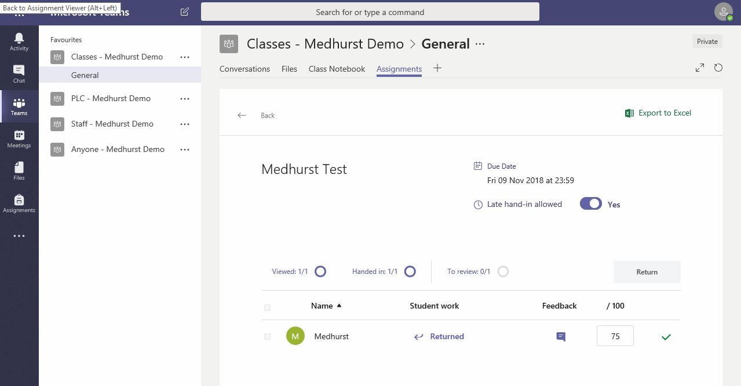
Assignment Review

Slide 19
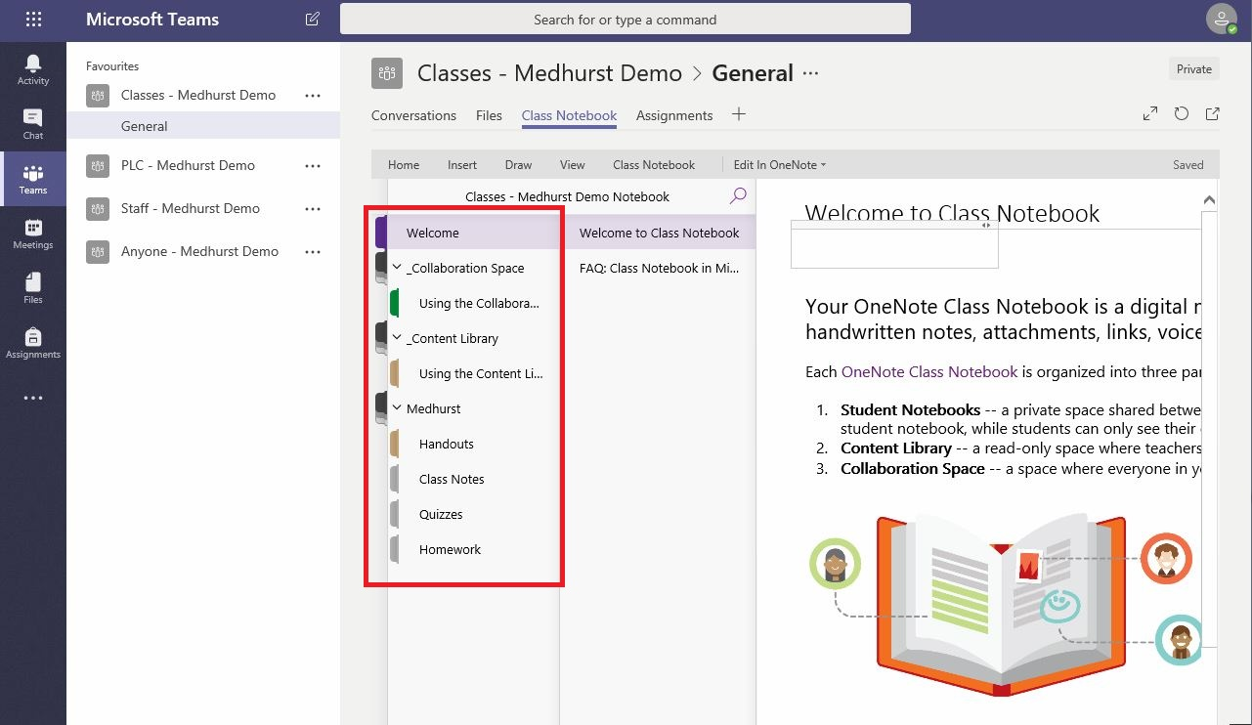
Class Notebook

Slide 20
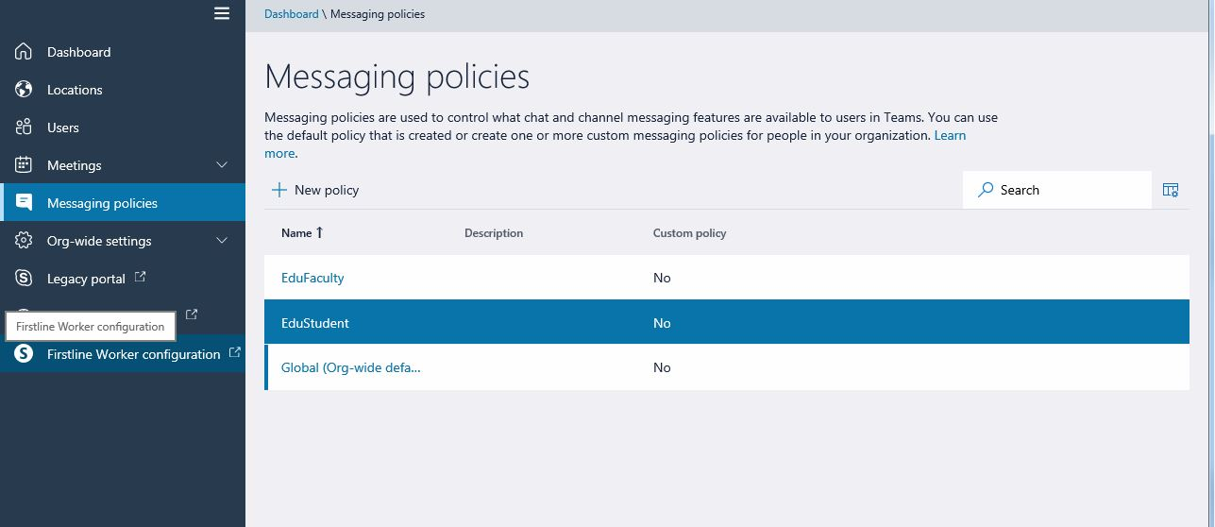
Message Policies

Slide 21
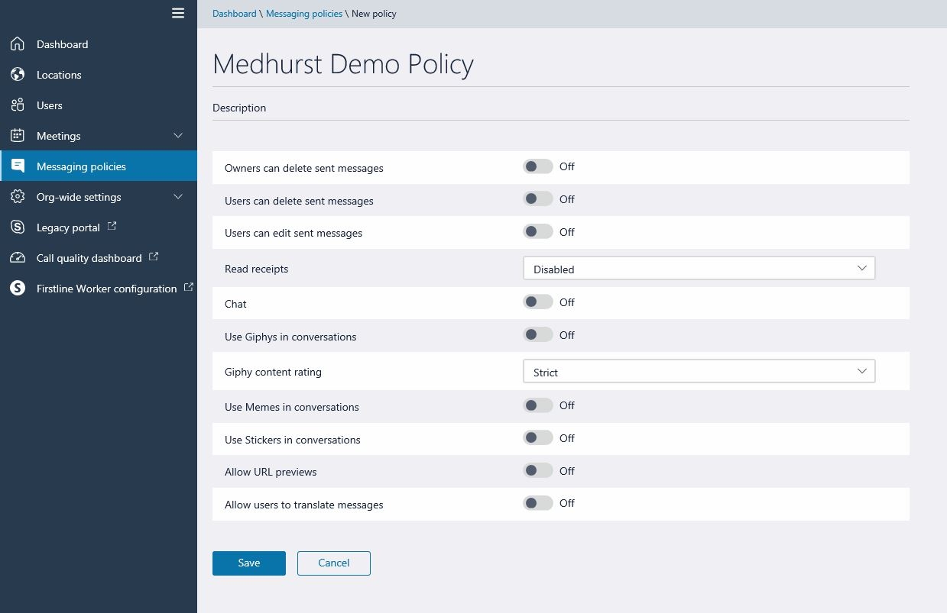
Demo Policy

Slide 22
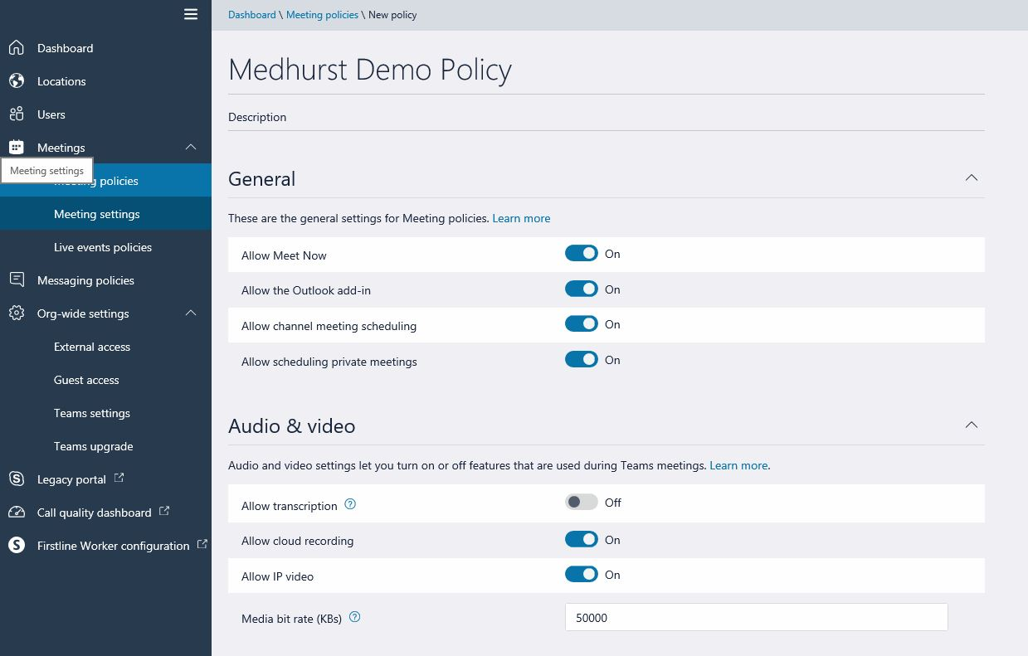
Meeting Policy

Slide 23
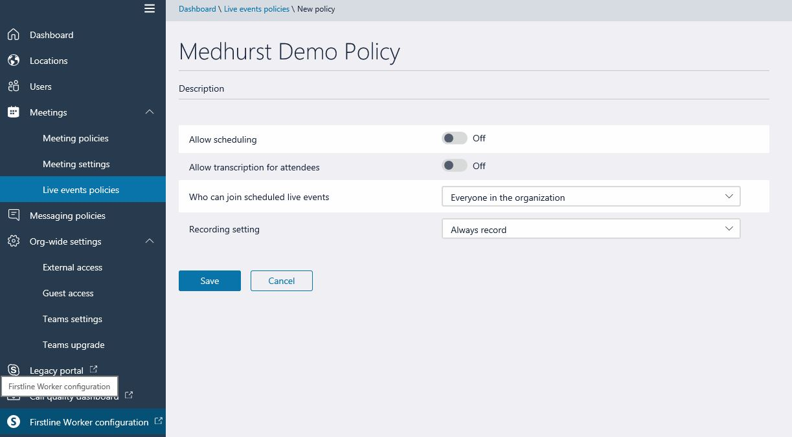
Live Event Policy

Slide 24
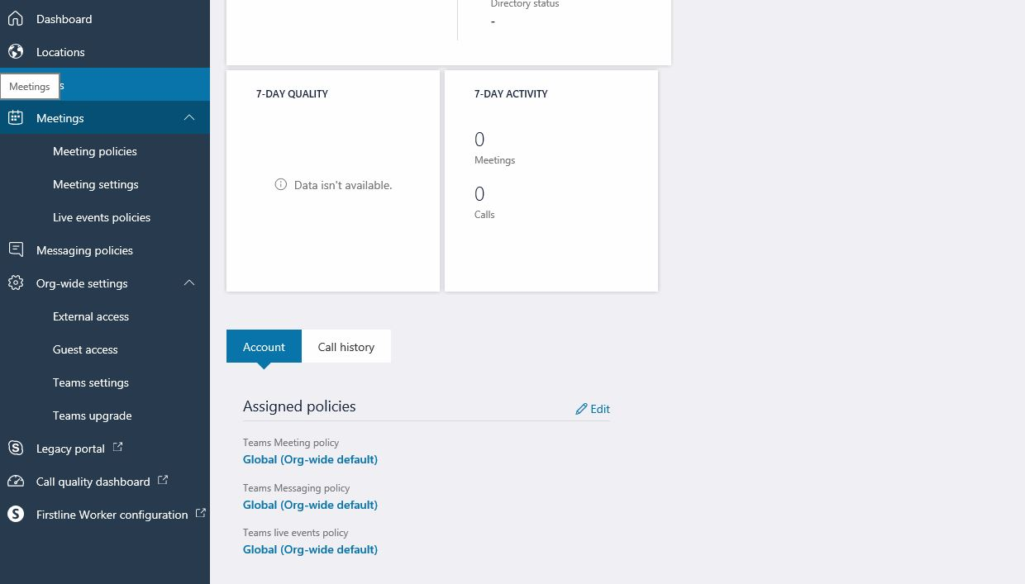
Policy Assignment

Slide 25
Sharepoint and Teams
Permissions, Version History and the Recycle Bins

Slide 26
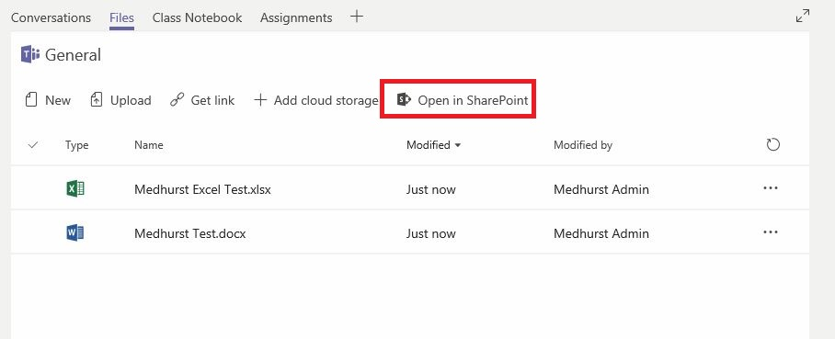
Teams File Browser

Slide 27
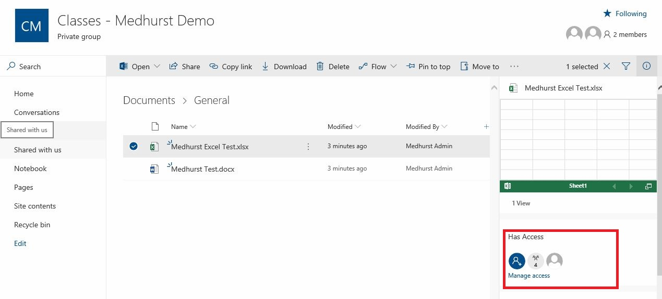
File Access

Slide 28
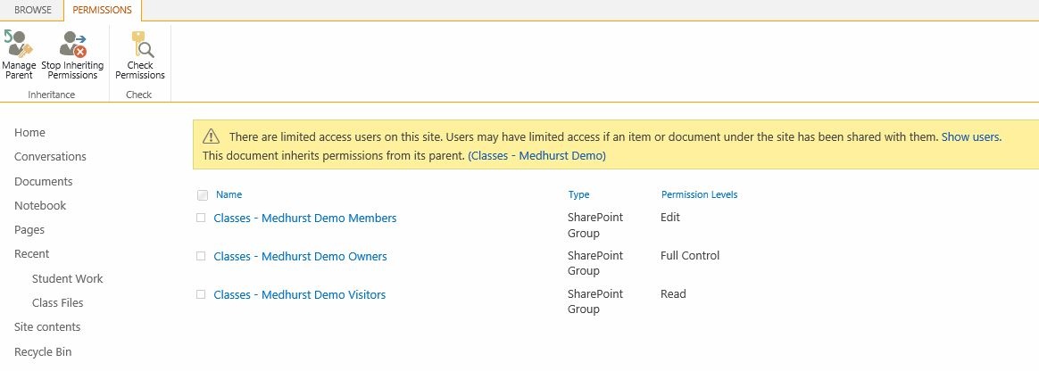
File Permissions

Slide 29
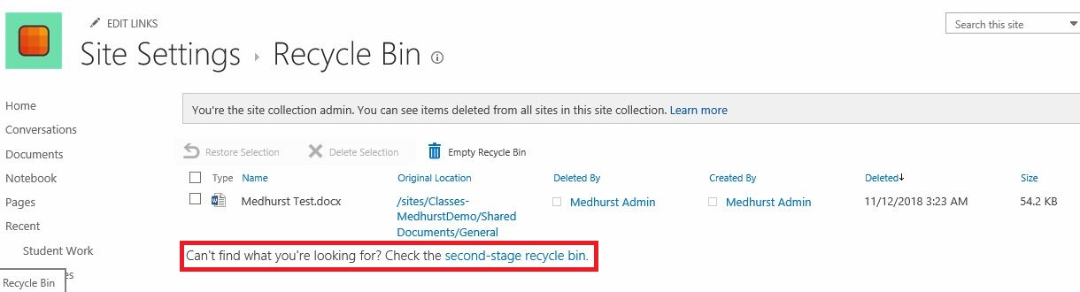
Recycle Bin

Slide 30
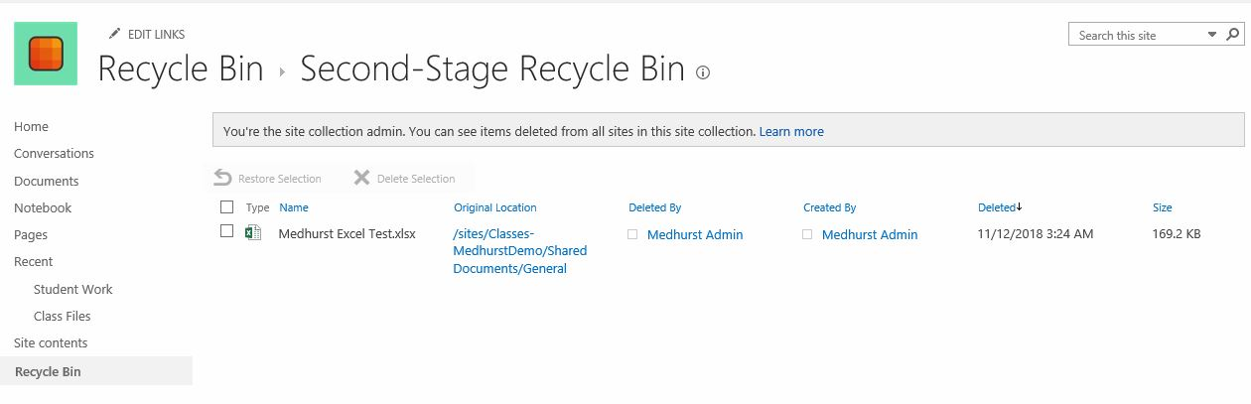
Second Recycle Bin

Slide 31
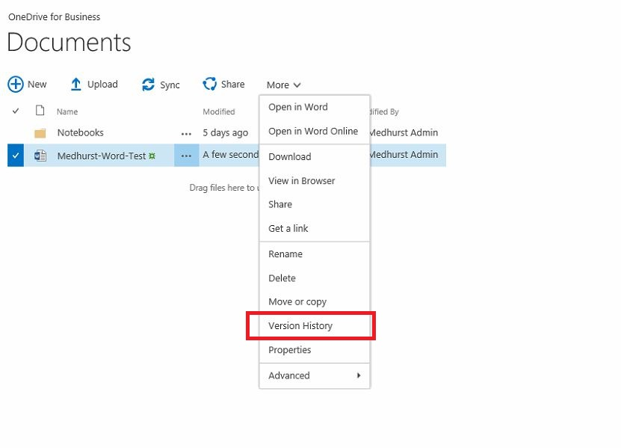
Version History for a File

Slide 32
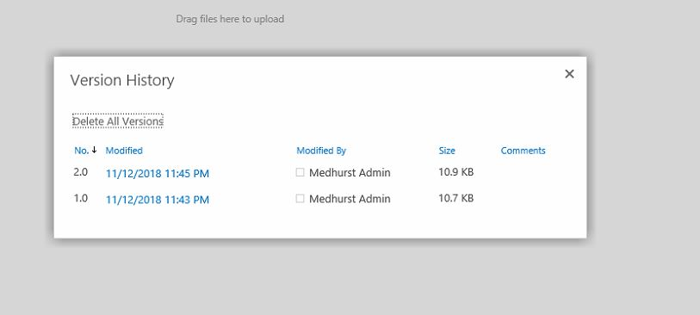
Restoring a Previous Version

